Slide 1
CleanPowerSF 2022 Integrated Resource Plan December 13, 2022

Slide 2
Agenda
Integrated Resource Plan Intro
Modeling Results
Community Engagement
Portfolio Evaluation
Next Steps and Implementation

Slide 3
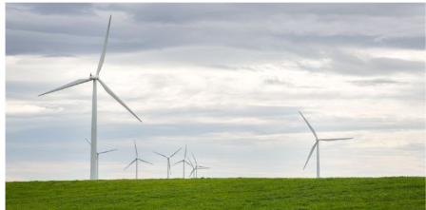
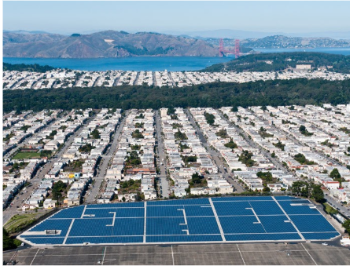
What is an Integrated Resource Plan (IRP)?
An IRP is an energy planning tool to support achieving policy goals and meeting regulatory requirements.
State law requires retail sellers of electricity to develop an IRP that evaluates electricity supply and demand and identifies energy resource options that can deliver reliable and cost-effective energy to customers.
CCA IRPs are reviewed and certified by the California Public Utilities Commission (CPUC), every two years.

Slide 4
Integrated Resource Plan Portfolios
Conforming Portfolio
Alternative Portfolio
Accounts for local goals and targets:
Provides flexibility to incorporate community preferences
Minimal flexibility to incorporate local electrification goals and targets
Transportation electrification
Building decarbonization
Accounts for statewide goals and targets
Uses inputs and assumptions provided by the CPUC
Uses inputs and assumptions determined by CleanPowerSF

Slide 5
Summary
The SFPUC adopted the 90% Time Coincident Case portfolio as CleanPowerSF’s “Preferred Portfolio” in its 2022 IRP because it balances program goals the best.
The 90% Time Coincident Case portfolio achieves 100% renewable and greenhouse gas free electricity by 2025 and meets customer usage in real time in 90% of all hours by 2030
CleanPowerSF’s 2022 IRP was submitted to the California Public Utilities Commission (CPUC) on the November 1st due date.

Slide 6
CleanPowerSF IRP Modeling:
Four Portfolios
1. Base Case: CleanPowerSF Goals by 2025
100% renewable and/or GHG-free by 2025
Local resource prioritization
2. CleanPowerSF Goals and Time Coincidence by 2030
100% renewable and/or GHG-free by 2025
Resource generation meets customer usage in real time
CleanPowerSF analyzed the resource needs to meet both 90% and 95% time coincidence by 2030
No system purchase 5-10pm
Local resource prioritization
3. CleanPowerSF Goals and Climate Action Plan (Mayor’s EV and Building Decarbonization Targets Met)
100% renewable and/or GHG-free by 2025
Local resource prioritization
Emission-free passenger vehicle trips originating in, ending in, or passing through San Francisco by 2040
Decarbonization of existing buildings by 2040
4. CleanPowerSF Goals and Local Resource Procurement
100% renewable and/or GHG-free by 2025
Local content floor of 50% by 2030

Slide 7
Local Investment
All portfolios analyzed include 85.6 MW of local solar, 150 MW of local battery storage, and 50 MW of local geothermal
This represents $600-$700 million commitment to local projects*
*Estimated cost of local resource contracts through 2045.

Slide 8
Modeling Results Comparison of Conforming Portfolios

Slide 9
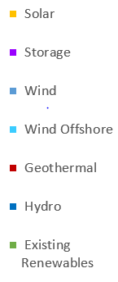
Comparison of Conforming Portfolios: Total Portfolio Capacity by Technology (2035)

Slide 10
Comparison of Conforming Portfolios: Energy Generated by Resource Type (2035)
4,060,895 megawatt-hours (MWh)
6,841,623 megawatt-hours (MWh)
4,517,730 megawatt-hours (MWh)

Slide 11
Comparison of Conforming Portfolios: Average Portfolio Costs (2023-2035)

Slide 12
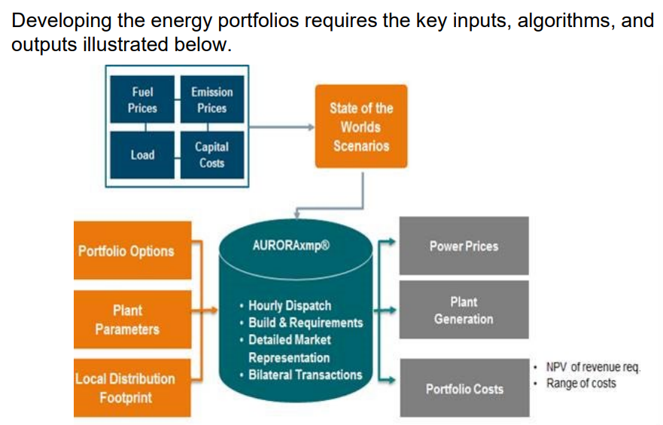
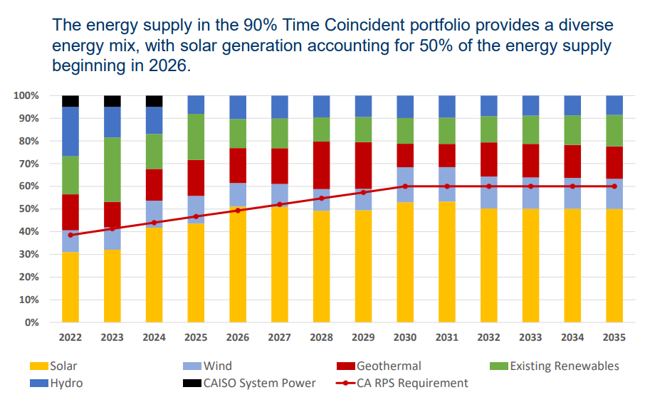
Comprehensive Modeling Results
For more information and comprehensive modeling results visit cleanpowersf.org/resourceplan :

Slide 13
Community engagement

Slide 14
Community Engagement & Feedback
Outreach Summary
Phase 1 (June - July)
Input & feedback accepted via digital survey from Jun 5th to Jul 6th
68 responses received
Two virtual community workshops held (6/21, 6/23)
Invited 600+ community stakeholder groups and their respective staff
24 participants from more than 15 different community-based organizations
Key themes we heard: Affordability/Equity, Reliability, Sustainability
Phase 2 (Sept - Oct)
Written public comments were accepted online from Sept 20th to Oct 14th
14 comments received using online form, 2 letters received
Two virtual community listening sessions held (9/29, 10/5)
Written comments received expressed a range of perspectives:
Emphasis on electric system reliability and affordability (i.e. rates)
Interest in understanding the role of distributed energy resources, including rooftop solar, energy efficiency and demand-response
Support for the 90% Time Coincident portfolio with interest in seeing higher time coincidence in future Integrated Resource Plans

Slide 15
Portfolio Evaluation

Slide 16
CleanPowerSF Portfolio Evaluation
Lead with Affordable and Reliable Service
Portfolio Cost ($/MWh)
Portfolio Reliability
Resource Diversity
Provide Cleaner Electricity Alternatives
Portfolio Emissions
Renewable Energy Content
Invest in Local Renewable Projects and Local Jobs
Invest in Local Renewable Projects and Local Jobs
$ Invested Locally
MW Developed Locally
Job Development Potential
While Providing for Long-Term Rate and Financial Stability
% Long-term Contracted
Market Exposure (Net Market Purchases)

Slide 17
Preferred Portfolio Ranking (1 = best, 3 = worst)
Cases13 | Base | 90% Time Coincident | 95% Time Coincident
Lead with Affordable Service
Cost | 1 | 2 | 3
Reliability | 3 | 2 | 1
Diversity | 3 | 2 | 1
Provide Cleaner Energy Alternatives
Emissions | Equivalent
Renewable | Equivalent
Invest in Local Projects and Jobs
Local Investment | Equivalent
Provide for Long-term Rate and Financial Stability
% Long-term Energy | 1 | 2 | 3
Market Exposure | 2 | 1 | 3
Total | 10 | 9 | 11

Slide 18
Preferred Portfolio
Staff recommended that the Commission adopt the 90% Time Coincident Portfolio because it best balances CleanPowerSF program goals:
Affordable
The 90% Time Coincident Case has total portfolio costs comparable to CleanPowerSF’s 10-year financial plan supply costs
Reliable
The 90% Time Coincident Case exceeds the CPUC-assigned annual reliability target and would improve the program’s ability to serve demand on a real time basis
Cleaner
The 90% Time Coincident Case achieves the City’s 100% renewable goals
Supports Local Investment
The 90% Time Coincident Case includes an amount of local resources that is comparable to the other portfolios analyzed
Supports Rate and Financial Stability
The 90% Time Coincident Case provides long-term rate stability without over-building and creating unreasonable market risk

Slide 19
Next steps & Implementation

Slide 20
Next Steps and Implementation
Preferred Portfolio guides the procurement of CleanPowerSF’s contracted resources
Local Projects RFP
All source RFO for utility-scale resources
Joint procurement activities as part of CC Power
Refining sensitivity analyses, focusing on building decarbonization and transportation electrification
Kickoff for 2024 IRP cycle in late 2023/early 2024

Slide 21
Thank you!

Slide 22
Appendix

Slide 23
Key IRP Terms and Acronyms
Term (Acronym) | Meaning
Analytical Modeling | Mathematical technique used for simulating, explaining, and making predictions about a complex system
California Independent System Operator (CAISO) | Organization that manages California’s bulk electricity grid, transmission lines, and wholesale energy market.
California Public Utilities Commission (CPUC) | State energy regulatory agency that oversees the IRP process for Investor-Owned Utilities (IOU), Energy Service Providers (ESP) and Community Choice Aggregators (CCA)
Capacity | The maximum output that a generator can produce, it is typically expressed in terms of megawatts (MW) or kilowatts (kW)
Capacity Factor | A measure of how much energy is produced compared to the resource’s maximum capacity over a set period time, expressed as a percentage
Demand | The amount of electricity usage met by a retail seller over a given period of time
Energy | The ability to do work
Energy Storage | A technology which captures energy produced at one time and discharges it for use at a later time
Greenhouse Gas Free Resources | Electricity produced from generation sources that do not emit carbon dioxide or other greenhouse gas emissions as a by-product of power production, e.g., solar, wind, hydroelectric

Slide 24
Key Terms and Acronyms
Term (Acronym) | Meaning
Hybrid Resources | A generator that consists of two or more paired resource types eg., solar plus battery storage
Integrated Energy Policy Report (IEPR) | A biennial report issued by the California Energy Commission that contains an assessment of major energy trends and issues facing California’s electricity sector, including the demand forecast used in CleanPowerSF’s Integrated Resource Plan
Integrated Resource Planning | A process that evaluates future electricity demand and resource options over a long time horizon, typically 20 years, and optimizes the resource mix that meets set criteria at the lowest cost
Investment Tax Credit (ITC) | A federal tax credit available to investment in solar power facilities and co-located energy storage facilities
Job-years | A job creation metric which is equivalent to one full time job (2,080 working hours) for one year
Load Serving Entity (LSE) | A retail seller of electricity
Long-duration Energy Storage | Battery storage of various technology types which can discharge for 8 hours or more
Megawatt (MW) | 1,000,000 watts (a unit of power demand or generating capacity)

Slide 25
Key Terms and Acronyms
Term (Acronym) | Meaning
MMT CO2 | Million metric tons of carbon dioxide
Portfolio | A collection of power supply resources used to serve electricity demand
Preferred Portfolio | Of the portfolios modeled, the one which best meets program goals and regulatory requirements that is approved and submitted to the California Public Utilities Commission
Preferred System Plan | The portfolio developed by the California Public Utilities Commission with an aggregation of individual IRPs of all retail sellers subject to CPUC jurisdiction that includes the CPUC’s view of the optimal mix of resources for the state over the IRP planning horizon
Reliability Need | Share of resource capacity needed to meet the CAISO managed coincident peak assigned to retail sellers by the California Public Utilities Commission
Renewable Portfolio Standard (RPS) | California State program that requires a minimum amount of electricity in retail seller portfolios to come from eligible renewable energy resources
Resource Adequacy (RA) | A regulatory program intended to ensure that there are sufficient electricity generating resources to support reliable grid operation under peak demand conditions

Slide 26
Key Terms and Acronyms
Term (Acronym) | Meaning
Revenue Requirement | The total amount of money an electricity provider collects from its customers
RPS-Eligible Resources | Solar, wind, geothermal, small hydroelectric, or biopower facilities that are located within the Western Electricity Coordinating Council (WECC) region, which encompasses fourteen western U.S. states and portions of Canada and Mexico. The majority of RPS-eligible electricity currently comes from solar and wind.
Sensitivity Analysis | Analysis of the impact to the portfolio caused by a change to a variable in the analytical model
System Power | Electric generation supplied by the grid at a particular time that is not associated with a specific generating facility

